Slide 1
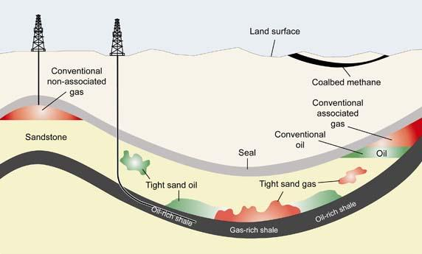
Formation evaluation and characterization of shale-gas reservoirs by means of core and wire-line data integration
Do not adjust the width of this textbox, just type within it
Team 4
Vladislav Ryzhov
Daniil Sherki
Yana Snegireva
Evgeny Serebrennikov
Magomed Taimaskhanov
Notes:
Shales form a particular petroleum system wherein the same rock formation is simultaneously source, reservoir rock, sealing rock and the trap, while gas migration occurs solely in a micro-scale or is absent. Quite a challenge for the petrophysicists who have to use more advanced techniques of research, especially in micro- and nano-scale.
Shale properties can be described in different scales of observation:
mineral grains (nano- and micro-scale),
packages of lithologically-uniform laminae (millimetre or centimetre scale),
higher order sedimentary complexes displaying internal lithological variability and higher order patterns of the sedimentary structure (scale of metres).

Slide 2


Shale is of strong heterogeneity…
Do not adjust the width of this textbox, just type within it
Notes:
Shale is of strong heterogeneity. The mineral composition has a significant influence on the diagenetic evolution, pore network formation, hydrocarbon content, oil mobility, and reservoir stimulation of shale. Accurate mineral analysis of shale is an essential precondition for scientific research and industrial production.

Slide 3
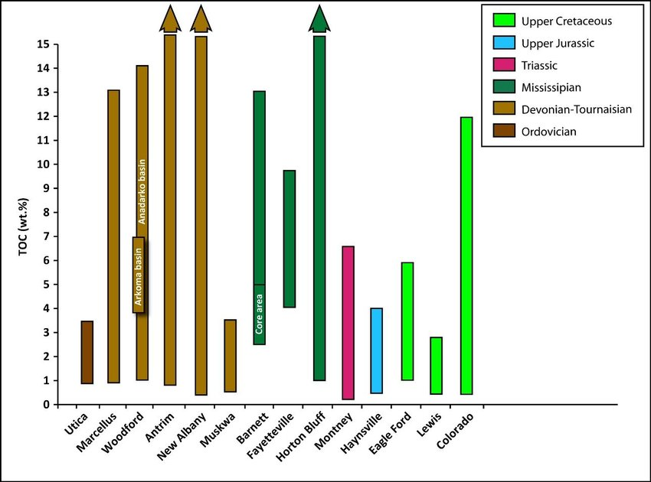
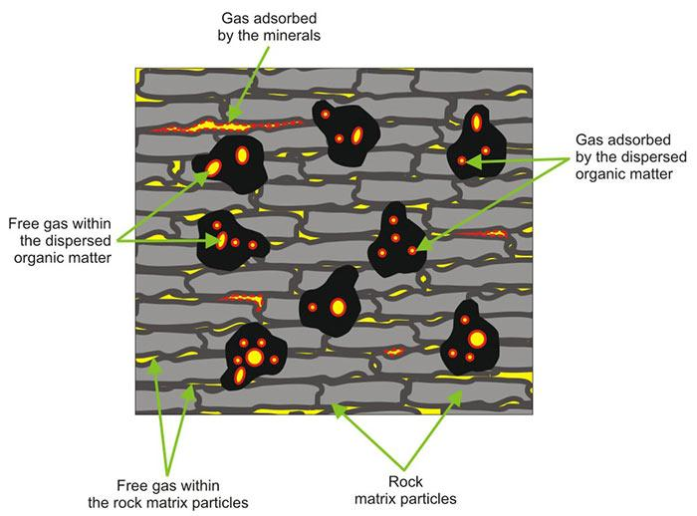
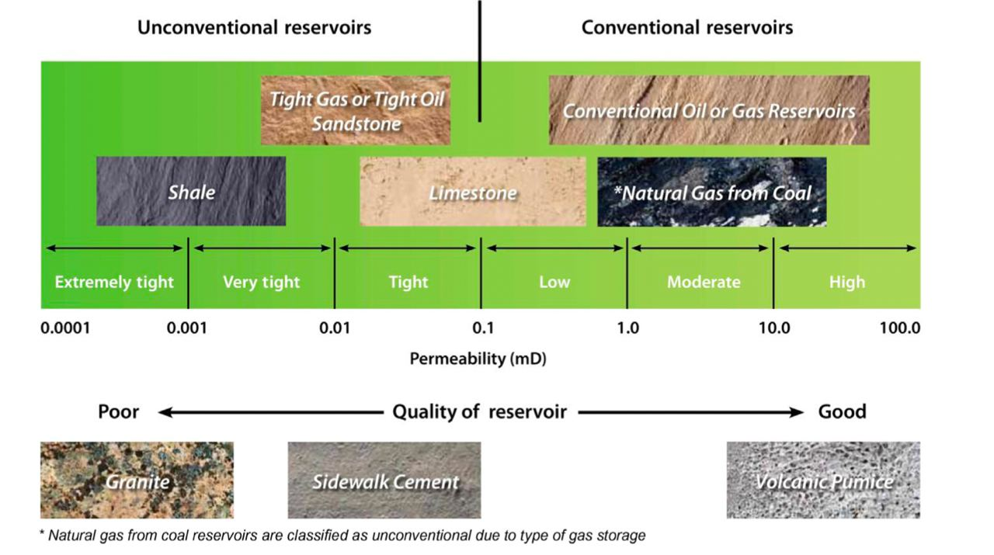
TOC
porous structure
permeability
Do not adjust the width of this textbox, just type within it
PROPERTIES
Notes:
Total organic carbon (TOC) is the amount of carbon found in an organic compound and is often used as a non-specific indicator of water quality or cleanliness of pharmaceutical manufacturing equipment. TOC may also refer to the amount of organic carbon in soil, or in a geological formation, particularly the source rock for a petroleum play; 2% is a rough minimum.For marine surface sediments average TOC content is 0.5% in the deep ocean, and 2% along the eastern margins
Shale structure - ultra-low permeability / very high density

Slide 4
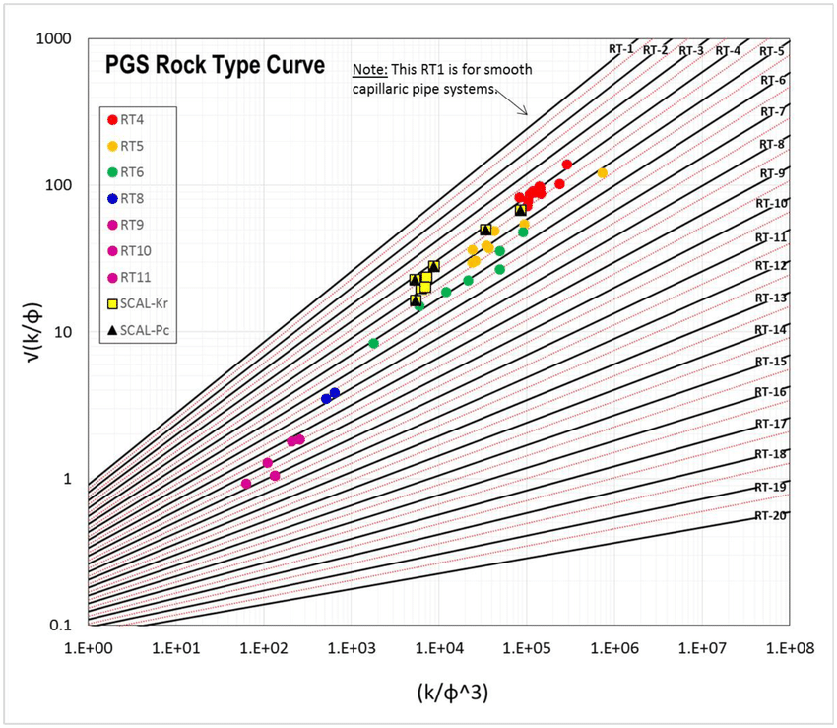

rock type classification
mineralogy
Do not adjust the width of this textbox, just type within it
Notes:
Sedimentary rocks Petroleum may occur in any porous rock, but it is usually found in sedimentary rocks such as sandstone or limestone. Sedimentary rocks are grouped into three major classes: clastic, carbonate, and evaporitic.
Mineralogy is the systematic study that extensively covers description, crystallography, physical, chemical and environmental features of all minerals.

Slide 5


Mineralogy evaluation
analysis process
purpose
Raw material analysis
mineral diagnostic
concentration determination
determination of traces
sampling
grinding
homogenizing
fractionation
homogeneity test
Methods
IR spectroscopy
Thermal analysis
Chemical analysis
Resonance methods
Radiographic analysis

Slide 6
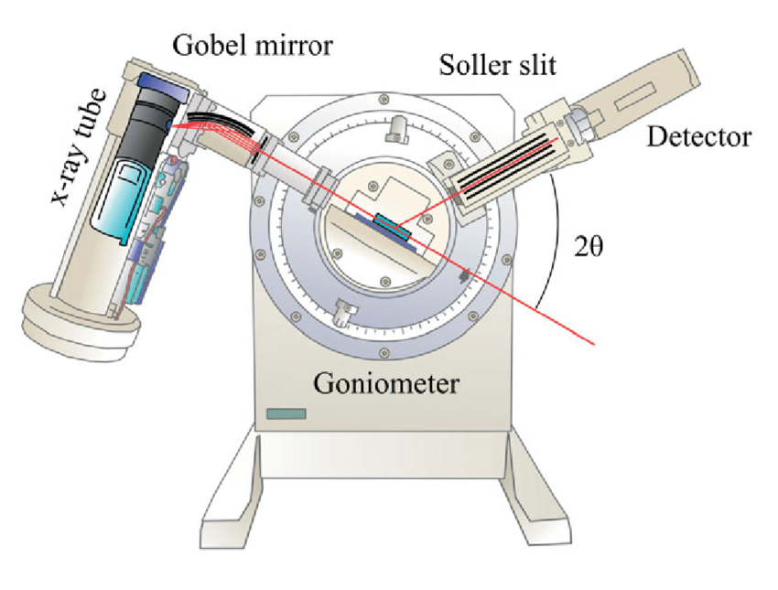
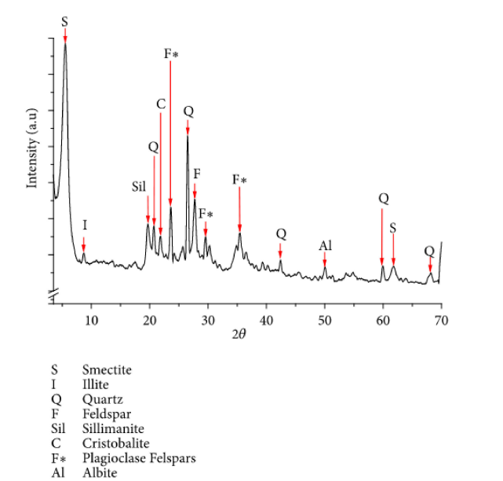
X-ray diffraction

Slide 7
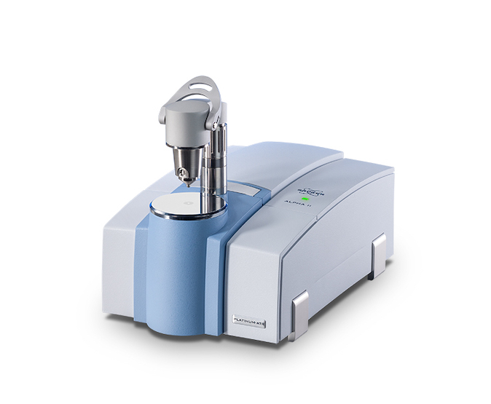
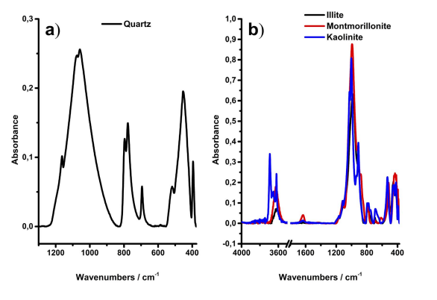
Infrared spectroscopy
Bruker Alpha FTIR spectrometer
Infrared Attenuated Total Reflectance Spectroscopy: An Innovative Strategy for Analyzing Mineral Components in Energy Relevant Systems Christian Menno Mu¨lle Bobby Pejcic1 , Lionel Esteban1 , Claudio Delle Piane1 , Mark Raven3

Slide 8
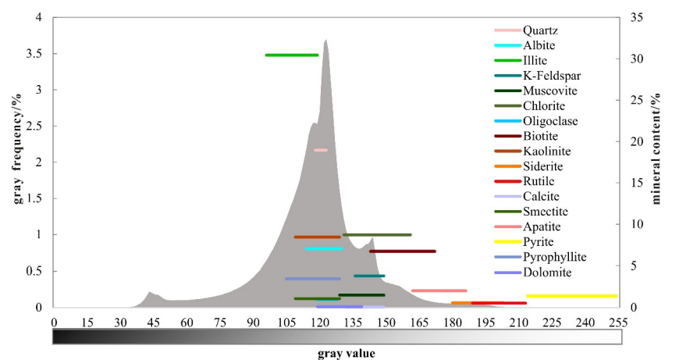
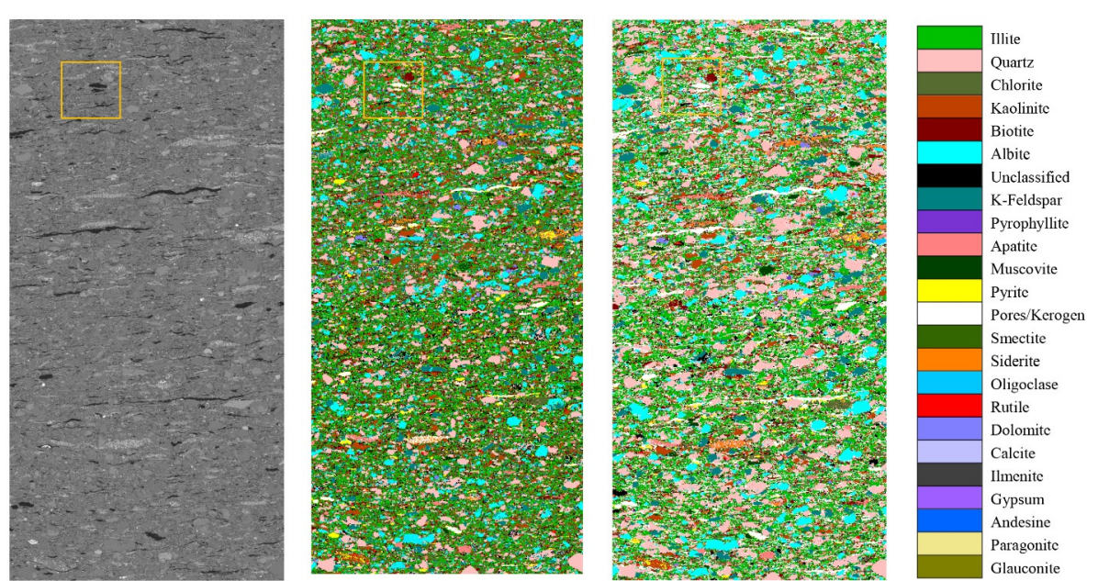
Evaluation of Minerals by Scanning Electron Microscopy
QEMSCAN Based on MAPS Technology
Shale Mineralogy Analysis Method: Quantitative Correction of Minerals Using QEMSCAN Based on MAPS Technology Senhu Lin, Lianhua Hou and Xia Luo 1

Slide 9
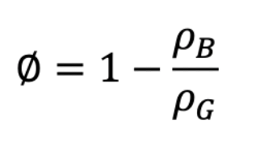
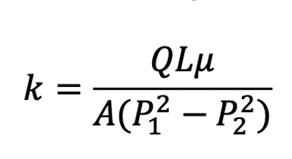
Laboratory methods applied to porous media of the shale rocks
Conventional rocks
Disadvantages using conventional methods for the shale rocks
using bulk density and grain density
Darcy’s gas flow (mostly use helium)
shales delaminating as core plugs are taken
nm-scale so may be less accessible to methane than to helium
methane adsorption may lead to the swelling of organic matter
slippage, transitional flow or Knudsen diffusion gas flow mechanism in shale rocks
Notes:
There are four reasons why conventional methods are not applicable for the shale rocks. The first, when we extract core plug of the shale rocks from depth, which permeability is very low, the gas expands and creating micro fractions in plugs. The second, if we use methane to measure permeability, it’s absorbed in organic matter, and helium moves easier than methane, and the permeability will be overestimated

Slide 10
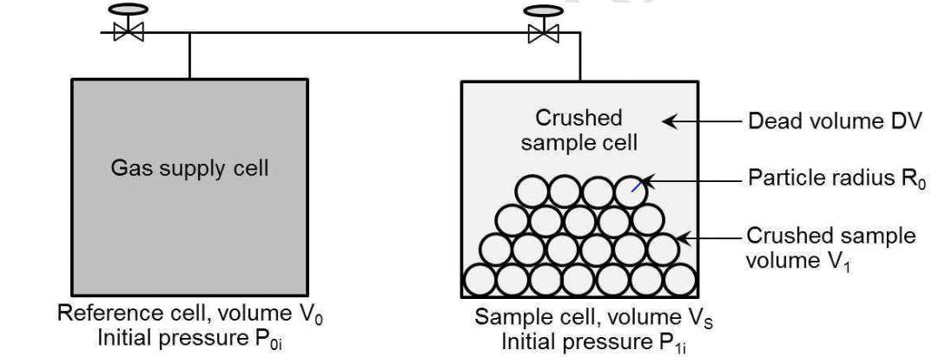
Crushing shale method (CSM)
1.Crushed shale is placed into a sample chamber into which helium gas isexpanded from a reference chamber at a known initial pressure.
2.The pressure rapidly drops to a value dictated by the dead space in the sample cell, then it decays more slowly to a lower pressure as the gas moves into the pores within the crushed shale particles.
3.Material balance is then used to calculate the grain volume and analytical or numerical methods are used to invert the pressure transient to calculate an apparent permeability.
4.Bulk density is usually measured separately using mercury immersion.
Notes:
The most popular methods for porosity measurement in shale rocks called crushing shale methods. The workflow for this experiment shown on this slide
We fill reservoir with crushing shale with pressurized helium and use material balance method to measure grain density. Bulk density is usually measured separately using mercury immersion.

Slide 11
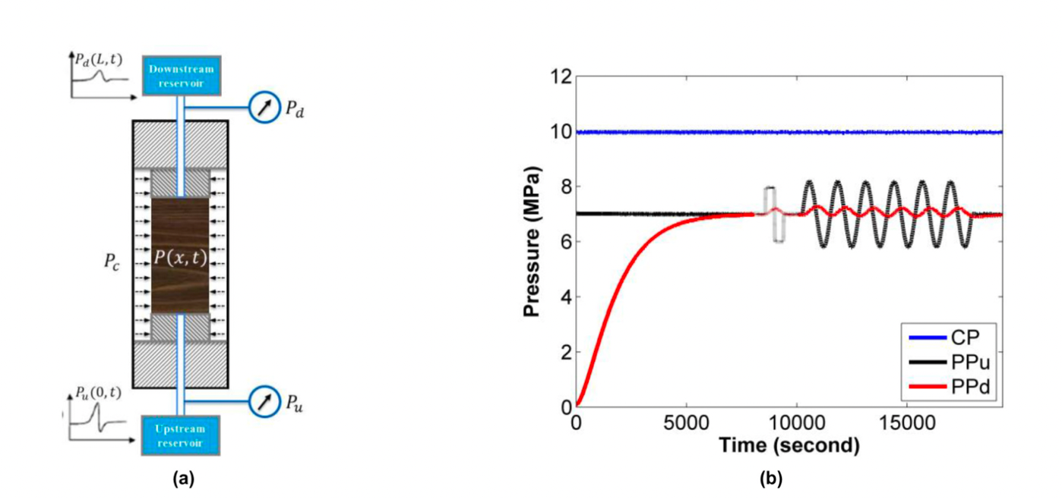
Laboratory setup for measurement permeability rich-organic shale rocks and measurement results
3 methods for permeability measurement:
1.Pressure build-up methods
2.Pulse-decay method
3.The oscillating pulse method
PPu - the pressure change at the upstream side
PPd- at the downstream side
Schematic diagram of the experimental setup for measuring the transient permeability of unconventional shales
Typical pore pressure profile during the permeability measurement of a plug under the confining pressure
Notes:
We can see the setup for permeability measure in shale rocks on this slide.. This setup has two reservoirs: upstream and downstream, and two manometer for pressure change registration. We have 3 most popular for permeability measurement which called transient pressure methods
Pressure build up method, when permeability in upstream reservoir changes like this, and records pressure reaction in downstream reservoir. Other two methods are similar, but we for pulse-decay method a small pressure pulse is rapidly applied to the upstream side, and to the oscillating pulse method a small sinusoidal pressure wave applied. And with some mathematical model we can calculate our pressure

Slide 12
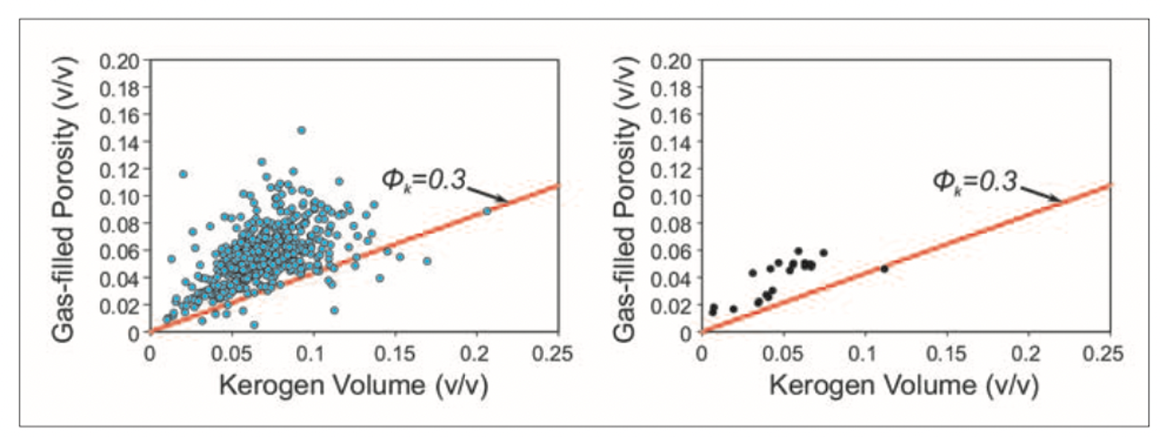
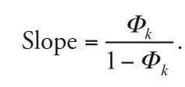
Article 1. Formation evaluation and characterization of shale-gas reservoirs by means of core and wire-line data integration
Way to partition the gas-filled porosity into matrix and organic porosity
Gas-filled porosity versus kerogen volume
Porosity, Ф_{k} associated with kerogen
Red line
minimum hydrocarbon volume
Notes:
This article tells us about formation evaluation and characterization of shale-gas reservoirs by means of core and wire-line data integration. Let start with talking about porosity overestimating. GRI says that often porosity is overestimated, because some share of gas reserves absorbed in organic matter, and we can create chart gas-filled porosity and kerogen volume and draw a red line on this chart whiсh slops depends by kerogen porosity
And if the point of this chart located under the line, we don’t count this point when we estimated porosity and free gas located in for the gas-filled porosity we need to consider this limitation
#If point lies on this line or under this line, we say that matrix porosity is equal zero

Slide 13
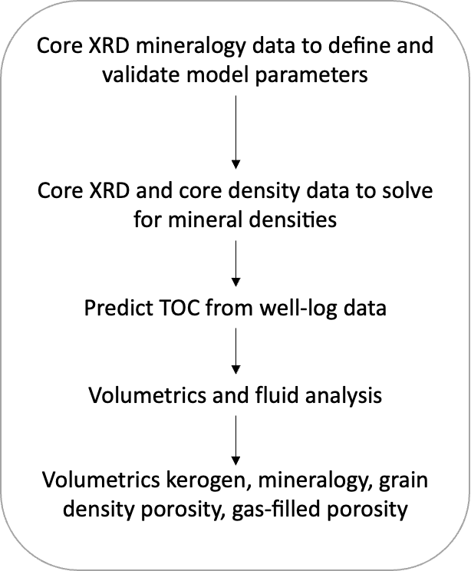
Volume kerogen, mineralogy, grain density, porosity, gas-filled porosity definition workflow
Possible ways to predicting TOC
• regression of core TOC versus core bulk density
• regression of core TOC versus core or wireline uranium
• applying the Δ log R techniques to predict core TOC from wireline logs;
• integrating multiple TOC indicators by an averaging technique to validate with cores
Notes:
# accurate wireline prediction of TOC is necessary to predict the adsorbed-gas component of the shale gas-in-placevolume
The author of the article says that there is a multi mineral method workflow when we use X Roentgen diffraction for estimation grain porosity even rock type.

Slide 14
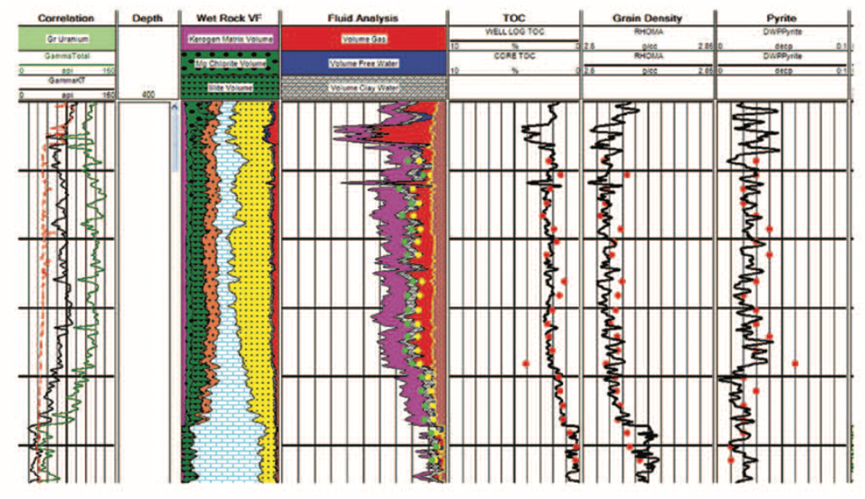
Haynesville geology
The Haynesville shale
Late Jurassic age
deposited in quiet water, within a restricted intrashelf (shallow-ocean) basin.
Clay content: 40% to 50%
TOC: 2% to 5%
mineralogy model:
illite (including mixed layer)
chlorite
quartz
calcite
plagioclase feldspar
pyrite.
Track 3 includes the kerogen matrix volume (magenta). Yellow circles represent the core gas-filled porosity, and green circles describe core porosity. The volume of gas is broken down into its matrix (red) and kerogen (dull red) components.
Notes:
And he was applying this method for Hensville shales and we have good results.

Slide 15
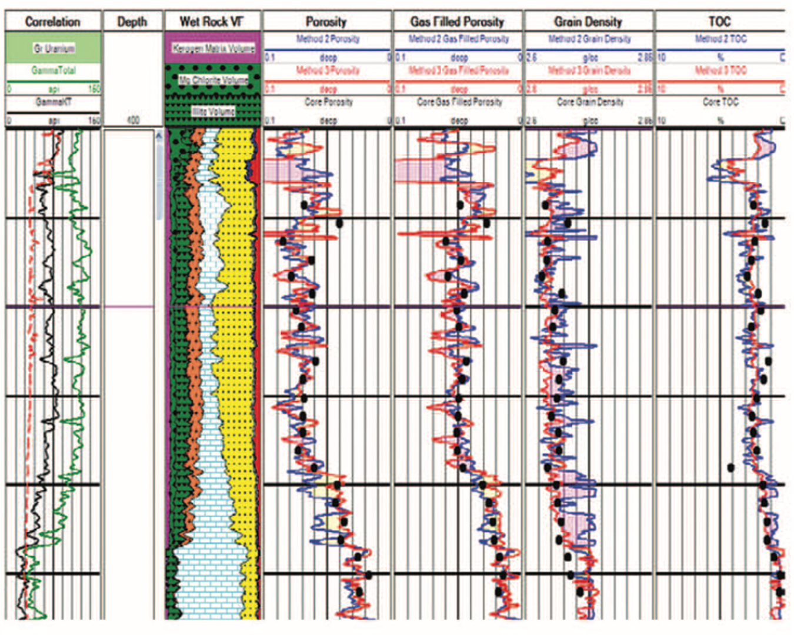
A compare two methods: simple and multimineralogical
The deterministic approach uses sonic, density, and resistivity data to compute TOC and gas-filled porosity.
A constant grain density is assumed, but a correction to grain density is made for pyrite and TOC(blue line)
Multimineralogical method – red line
Notes:
Then author compares this method with more simple deterministic methods with the probabilistic approach which assumes a constant grain density. And we have good convergence with this method when rock type is approximately constant. But this method worse then multi mineral model when mineralogy and grain density change quite rapidly
#The deterministic approach uses sonic, density, and resistivity data to compute TOC and gas-filled porosity. Again, a constant grain density is assumed, but a correction to grain density is made for pyrite and TOC.

Slide 16
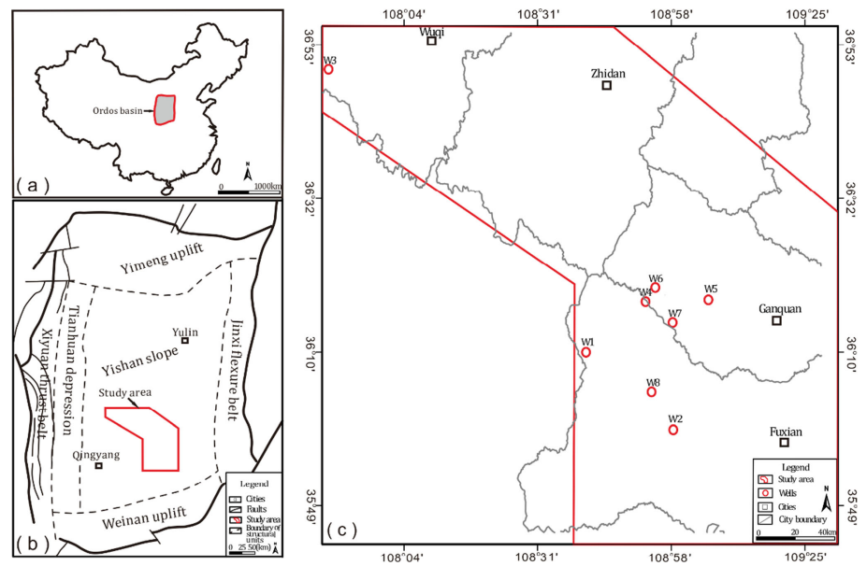
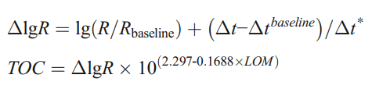
Article 2. TOC determination: Problem statement
Notes:
The Ordos Basin is located in the central part of China (See Fig. 1a).The distribution of cored wells is shown in Fig. 1c.
Total organic carbon content (TOC) is an important parameter for shale gas resource evaluation. Among the existing TOC prediction methods, ΔlgR method is the most widely used. R is measured resistivity and Δt is acoustic transit time.
There are two main problems in this method: 1) assuming a linear relationship between ΔlgR and TOC; 2) manually determining the baseline and introducing human error. In this case of strong heterogeneity, the relationship between well logs and TOC is complex and nonlinear, which leads to incorrect results for predicting TOC using ΔlgR method.
# When the resistivity log curve and the acoustic log curve of the non-source rock section overlap, it is the baseline, and the corresponding R_baseline and #Δt_baseline can be obtained. Δt* is the difference.
#Due to the frequent alternating changes in the sedimentary environments of continental shale, the heterogeneity of it is strong.

Slide 17
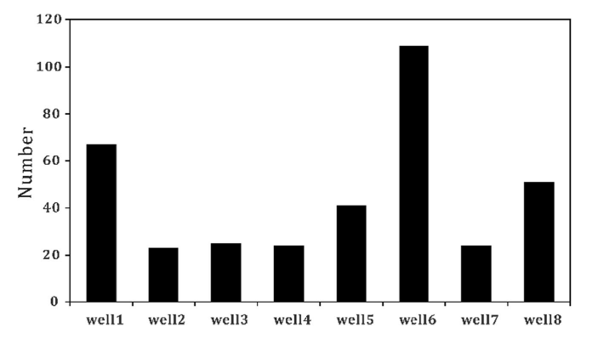
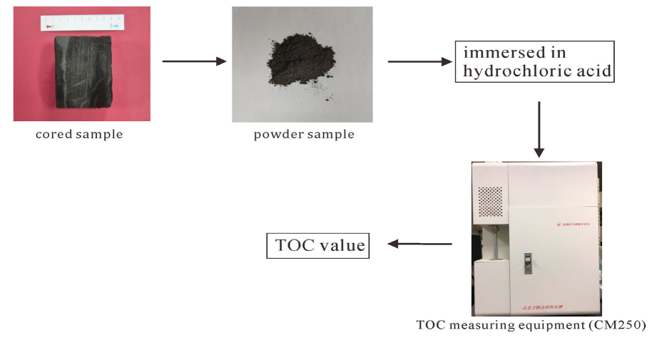
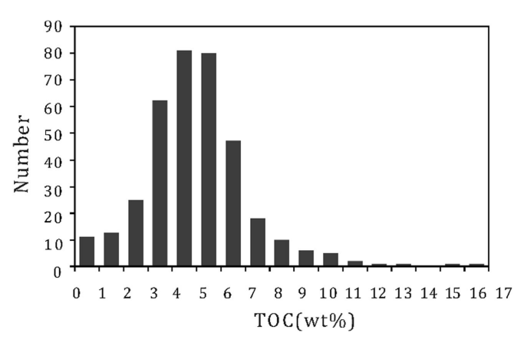
Article 2. TOC determination: TOC Data
Notes:
The cored samples were collected from Zhangjiatan shale of Yanchang Formation
This Figure demonstrates the measuring process of TOC values of cored samples.
Each sample was crushed into powder, taken about 0.1 g and immersed in hydrochloric acid to eliminate carbonate component. Then TOC value was analyzed using the TOC measuring equipment (CM250). A total number of TOC measured samples is 364. The measured TOC values range mainly between 3% and 7% (See Fig. 3).

Slide 18
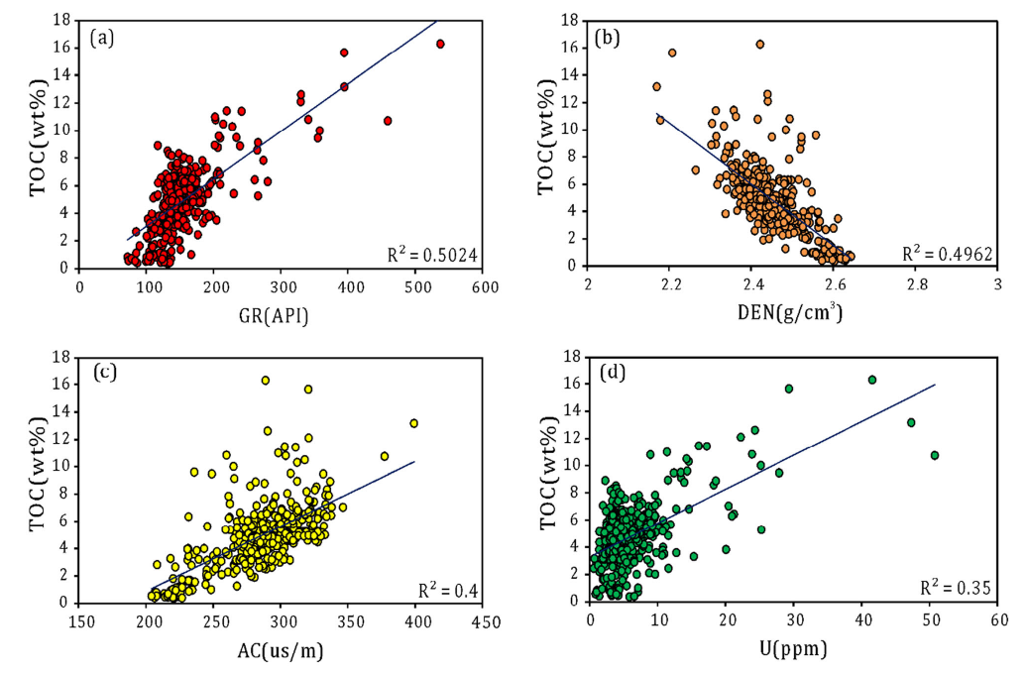
Article 2. TOC determination: Well-log Data
Notes:
In order to improve the accuracy of predicting TOC , it is necessary to select well logs that are more sensitive to TOC. As a result, natural gamma GR, density DEN, acoustic AC and uranium U logs were selected as the input data to establish SVR model

Slide 19
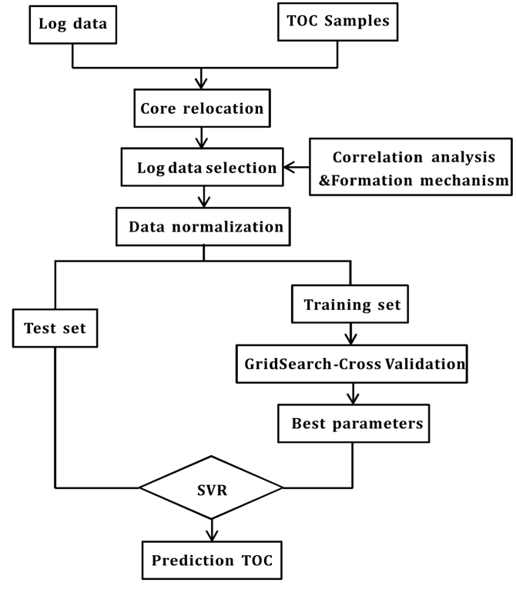
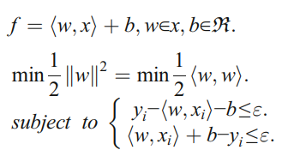
Article 2. TOC determination: Full process of TOC prediction
SVR:
Notes:
The objective of this paper is to develop a new empirical method to determine the TOC of continental shale using support vector regression (SVR). Three hundred sixty-four measured TOC samples of Zhangjiatan shale and the corresponding GR, DEN, AC, U logs data were used to construct the SVR model.
The SVR is aimed to obtain a function f as predicted value, where the error between the predicted value f and the true value y is the minimum.
# Meanwhile the function f is required to be as smooth as possible. If the error between the function f and true value y is within the allowable limit (≤ε), the #predicted result is considered correct.

Slide 20
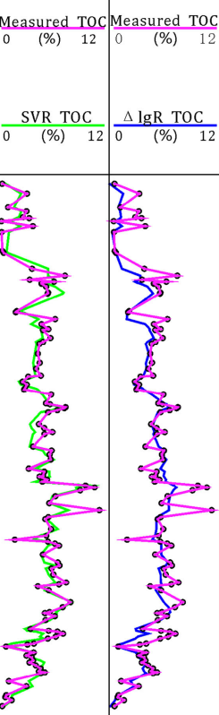
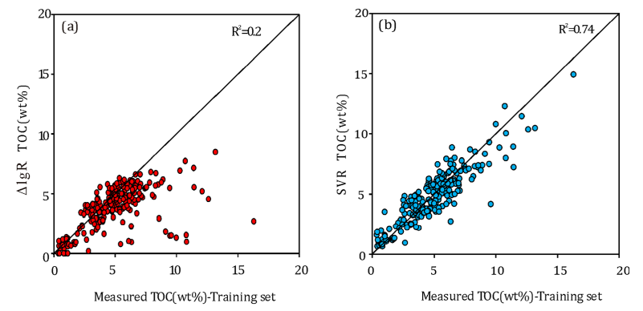
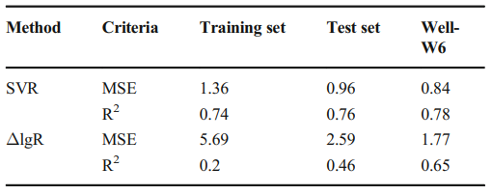
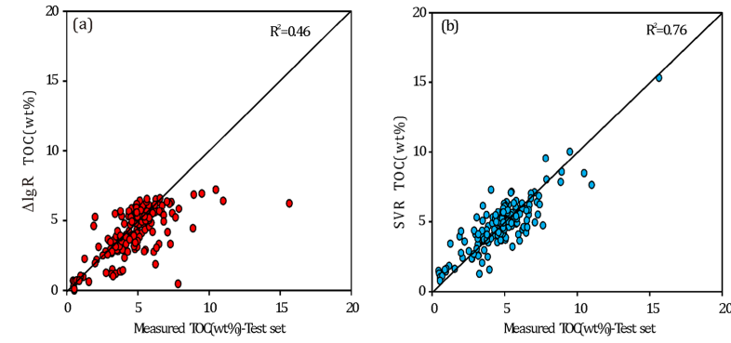
Article 2. TOC determination: Comparing of results ΔlgR method and SVR
Notes:
Compared with the ΔlgR method, the accuracy of the SVR model to calculate TOC is obviously higher.
This method is a well-adapted machine learning method, which can fit the nonlinear relationships between log data and TOC well.

Slide 21
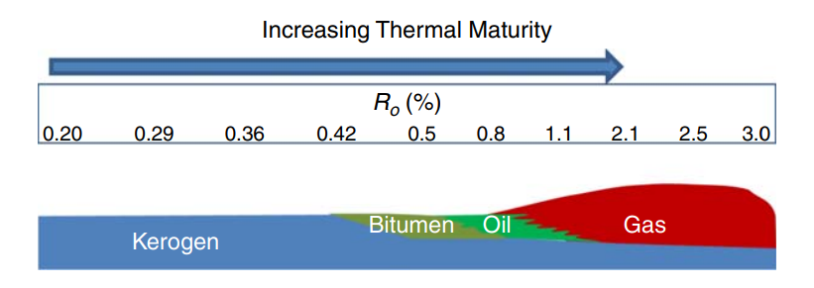
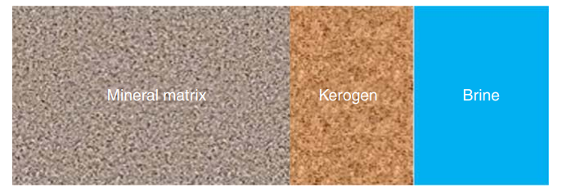
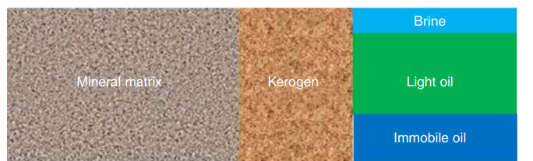
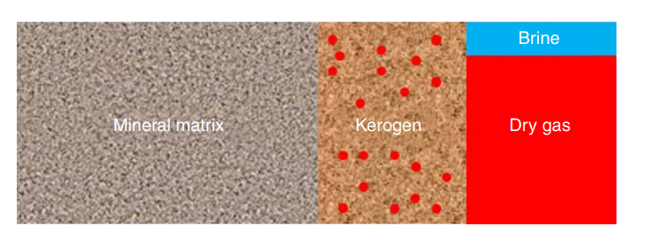
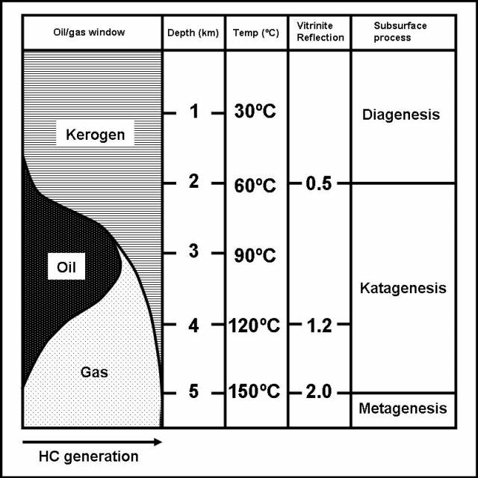
Article 3. Petrophysical models
Immature organic-shale source rock
Organic-shale-tight-oil reservoir
Mature shale-gas reservoir

Slide 22
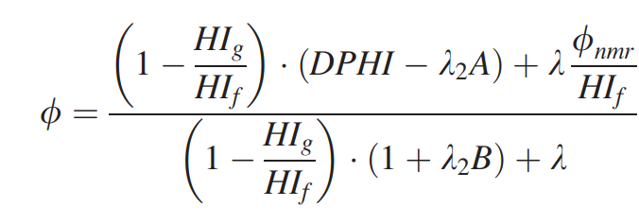
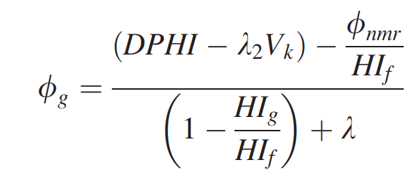
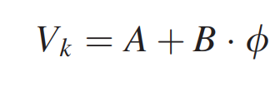
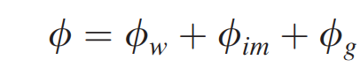
Article 3. Novel method for shale reservoirs evaluation
Bulk density
Nuclear magnetic resonance (NMR) total porosity
TOC weight fraction
Shale porosity
Kerogen volume
Fluid volume

Slide 23
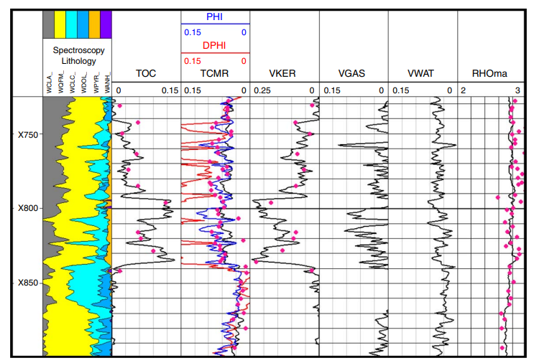
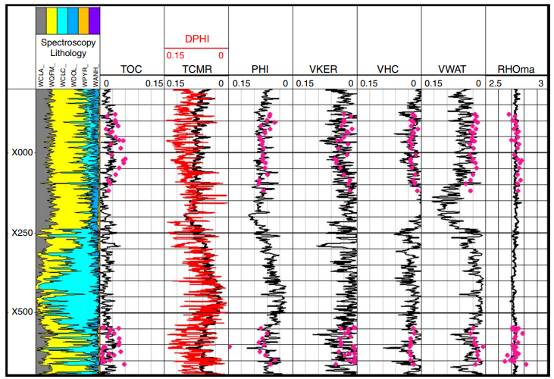
Article 3. Novel method for shale reservoirs evaluation
Evaluation of a shale-gas well from the Marcellus Shale in the northeast United States
Evaluation of a shale-tight-oil well from the Permian Basin in west Texas

Slide 24
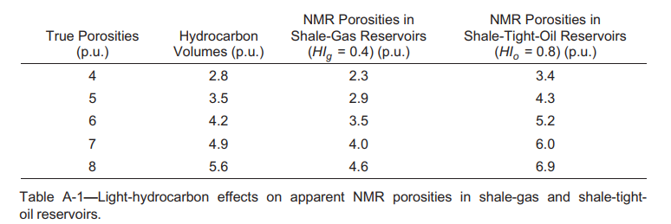
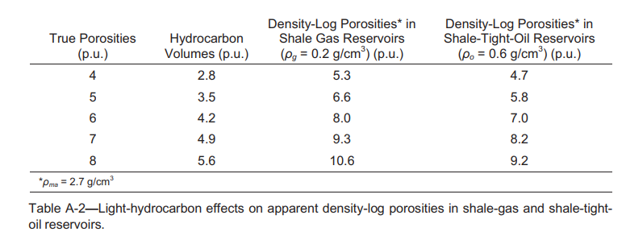
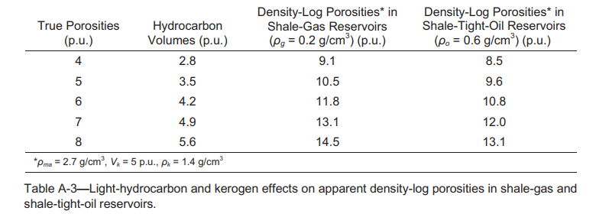
Article 3. Light HC and kerogen effects
Light- hydrocarbon effects on apparent NMR total porosities are much greater in shale-gas wells than in shale-tight-oil wells
The effect of kerogen on density-log porosities causes them to significantly overestimate the true-shale total porosities.
The kerogen effect on the apparent density-log porosities in organic shales can be much greater than light-hydrocarbon effects.

Slide 25
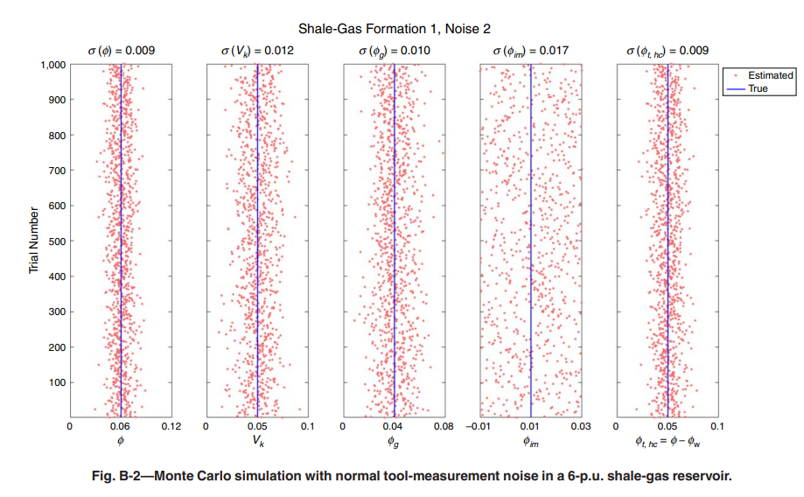
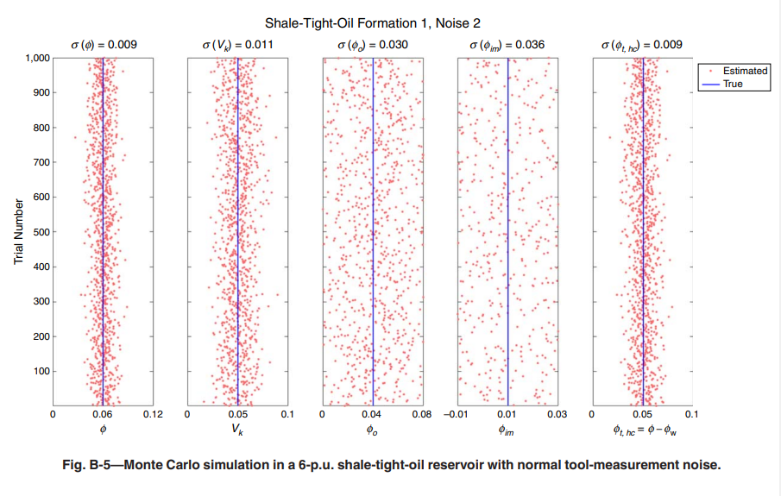
Article 3. Monte Carlo simulations
1. Porosities and kerogen volumes in shale-gas and shale-oil reservoirs can be robustly predicted under normal tool-noise levels.
2. Gas volumes in shale-gas reservoirs can be robustly predicted under normal tool-noise levels.
3. Total hydrocarbon volumes in shale-gas and shale-oil reservoirs can be robustly predicted under normal tool-noise levels.
4. Producible light-oil volumes in shale-oil reservoirs cannot be robustly predicted under normal tool-noise levels; however, they can be robustly predicted under reduced tool-noise levels, which requires stationary logging.

Slide 26
thx

